Slide 1

Development of multi-model E-commerce website using MERN Stack
IFET COLLEGE OF ENGINEERING
(An Autonomous Institution)
Department of Computer Science and Engineering
Code: CS8811
Done By: Rajeshwaran S (CSE Department)
Guided By: Ms.P.Dhivya (Associate Professor, CSE)

Slide 2
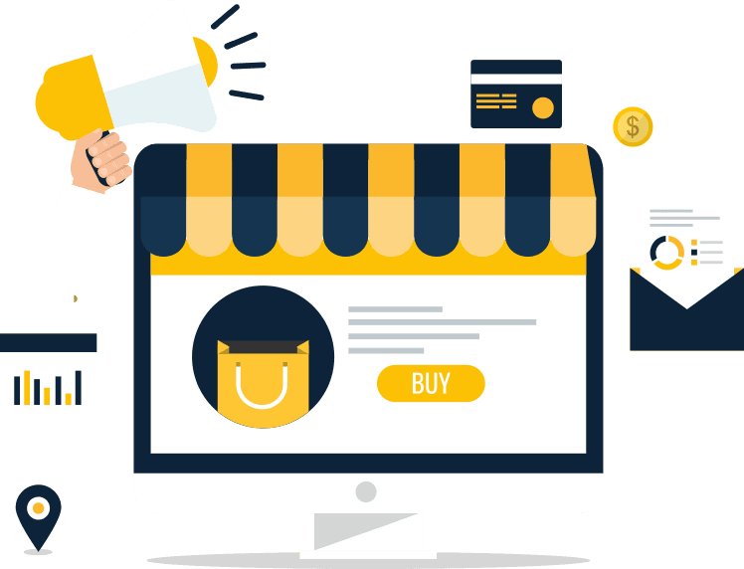
Synopsis
Abstract
Introduction
System Architecture
Data flow diagram
Module Design
Problem Definition
Existing System
Disadvantages
Proposed System
Advantages
Conclusion

Slide 3
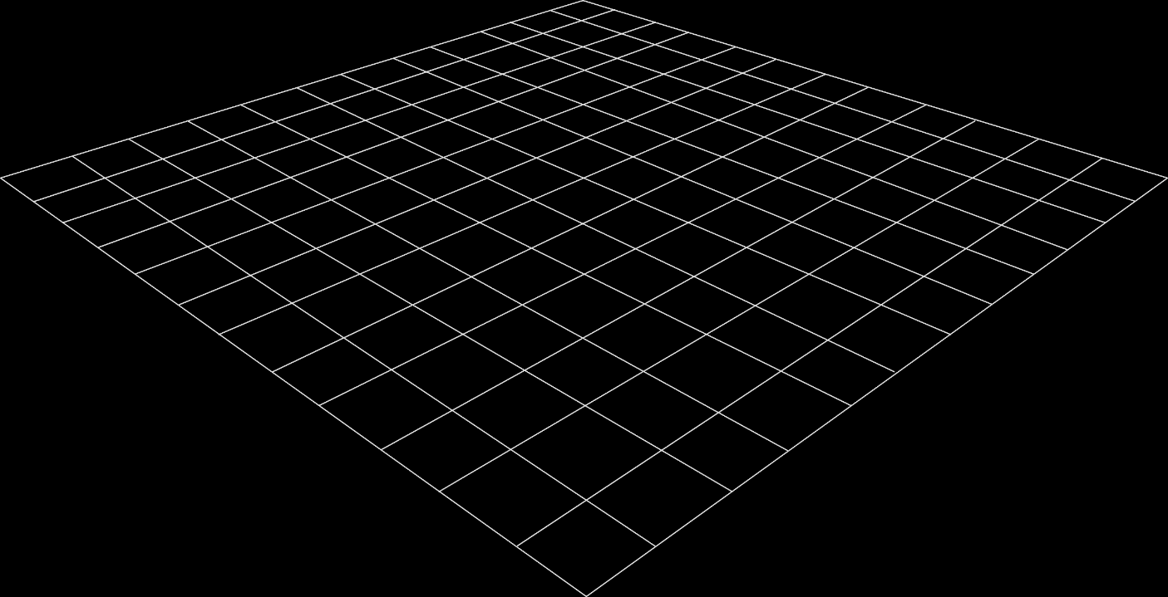
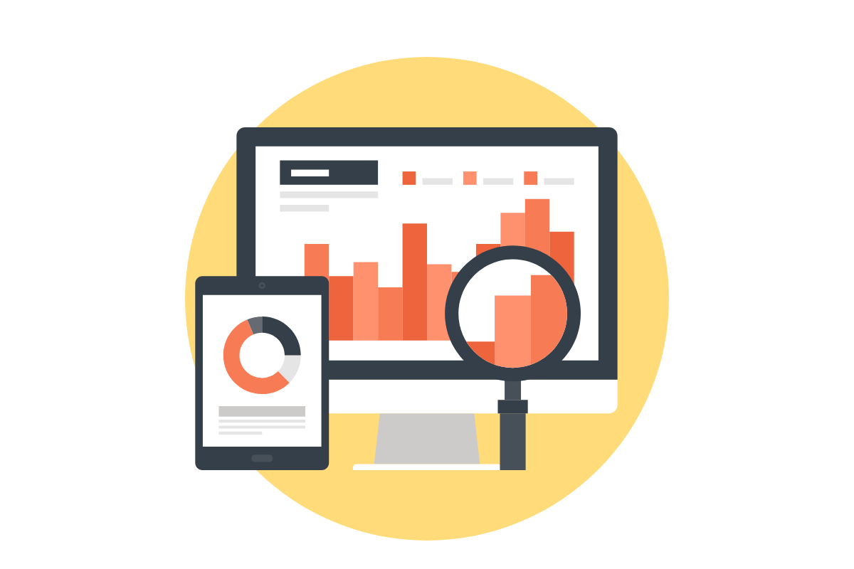
Abstract
E-Commerce (electronic commerce) is the buying and selling of goods and services, or the transmitting of funds or data, over an electronic network, primarily the internet.
Our suggested technology provides a secure online interface for purchasing things using a JWT token.
The features of our proposed project include JWT token for login and registration, Product ID to map the exact products from the DB,
Image search for the exact product category of the products to be matched,
Then, voice assistant to provide product ID suggestions as well as positive and negative ratings.

Slide 4
Introduction
We have basically squandered $1 million dollars by purchasing things through online shopping.
We are frequently misled by advertisements or other appealing characteristics into purchasing a product; yet, most individuals do not research the product before purchasing it.
We provide a recommendation system that can propose items to buy when shopping online.
The Recommendation system produces recommendations based on the product's previous and current ratings.
Furthermore, it allows you to search for Image search AI, among other things, to map the precise mapping on the items. In addition, we provide the product ID so that we can map the exact goods on our website.

Slide 5
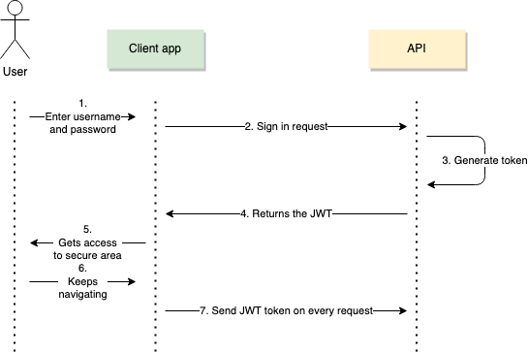
System Architecture – Login & Register

Slide 6
System Architecture – Client
User:
Login (JWT Token),
Register (JWT Token)
States: Validation,
Component Management
Redux:
axios to get API : MongoDB
Site:
BlasterShop
When you locate the site, it means it will take you to the states of our website; when you open it, it will take you to their individual states for login, registration, and adding items to your cart. These are the states of our site to map protected connections using JWT tokens.
Redux, which is used to keep track of our site's states, will then flow straight to the site. In addition, it specifies the action to be taken in order to obtain data from the API. The API can then be mapped to a reducer to return data as an Array of Objects.

Slide 7
System Architecture – Server
User : JWT TOKE()
Postman : API
CRUD Operation
MangoDB
In the server architecture, the processes are runs in the manner of Cycle. The data in Databases are to perform the CRUD operation like Create, Read, Update, Delete.
This is 24/7, fetching the data from the user, and that can be send and received by the respective database.
It is looks like time loop or repeated process, It works on the principle of MVC Architecture to do operations on DB.

Slide 8
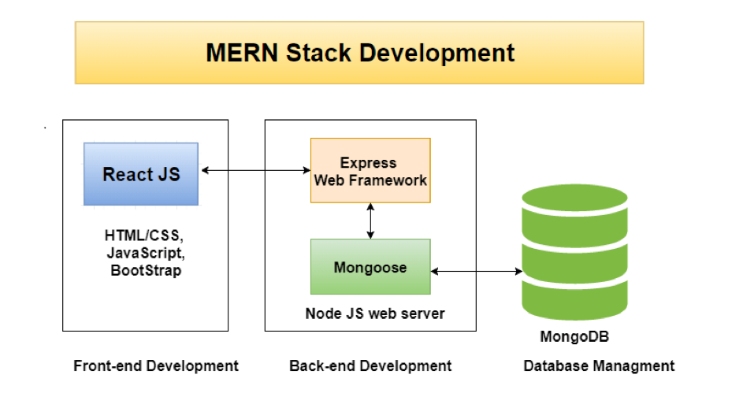

Data Flow Diagram
MangoDB : Store and Retrieve
user data
User Interface: Get user data
API : Send and Receive user data

Slide 9
Module Design
Module Name: MERN Stack – Client Server Architecture to give product review suggestions
Description:
MongoDB: A document-oriented, No-SQL database used to store the application data. Ex: To store the data of customer and product details, product review suggestion.
ExpressJS: A framework layered on top of NodeJS, used to build the backend of a site using NodeJS functions and structures. Ex: Get the routing action on the MongoDB server.
ReactJS: A library created by Facebook. It is used to build UI components that create the user interface of the single page web application. Ex: Front end framework to design and implement the web pages, API Call, Redux implementation, state management and designs.
NodeJS: The JavaScript runtime environment. It is used to run JavaScript on a machine rather than in a browser. Ex: Get the customer data to store on the MangoDB.

Slide 10
Problem Definition
People nowadays are interested in purchasing products from an internet retailer.
Books, technological and electrical devices, clothing, furniture, and medicine are all items that can be purchased via an online store.
Flipkart and Amazon now play a critical role in the online shop environment, providing 10 crore+ products that may be delivered worldwide.
Lenskart uses AI and ChatBot to get customers to buy and demo products from the comfort of their own homes.
Our program offers the same functionality, but it also includes a Voice Assistant, a ChatBot, a Product Recommendation System, Secured Login authentication using JWT token and products that can be found using QR codes and their product IDs to map the unique products.

Slide 11
Existing System
In the existing system, we have Amazon and Flipkart, These are the sites which will delivers the product in online stores to customer.
In the Flipkart had a recommendation to recommend the products which customer was already visited in their site.
Flipkart gives the recommendation based on searching or already visited products.
It will increase the productivity and readability of their site to attract the customer to buy their products
In Amazon, It provides the various services like It acts as the bank transaction medium.
It will have the voice assistant as ALEXA, to search for products. And also have the product recommendation system like Flipkart.

Slide 12
Disadvantages
The biggest problem is that it takes at least a day to deliver a product to the customer.
Takes more time to complete the orders
It will need more suggestion on product, which should more durable and quality.
It should not work for quantity and works for quality

Slide 13
Proposed System
Present we are using many sites to buy their product from various online stores. It gets rising many benefits to the customer and also rises many inconvenience to customer.
The problems are transaction failure, product miss match, product may be damaged while transportation of products from one location to another location.
These can be solved, that’s why I looks forward to proposed this solution to customer.
The Features are Voice Assistant, Image Search, Product Search using their respective ID which can be generated in the Database.
And also I want to implement in our site is that QR Code to Search the product effectively.

Slide 14



Proposed System
User
Voice Command
Product Suggestion
This is the architecture for voice assistant, which will suggest the users wants to looking for the products suggestions to buy.
The product suggestion which analysis the product rating and review of the customer has gave for that product.

Slide 15
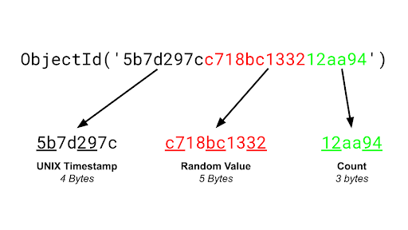
Proposed System
User
Product ID
Product Identification
This will maps the each product by using the respective product ID in the database, The Product ID can be generated by MongoDB.
When the user will gives the Product ID to our site, Our site will gives the exact match on our product from the Database.

Slide 16
Advantages
It will useful for the customer to buy products from remotely.
It will gives the suggestion based on the positive review on the products
It will identify the required product by using the image search to map the image from our site to give the related images in our site
It is fully responsive and UI friendly website, which can operate anyone without any prior knowledge in digital skills.
It will gives more recommendation than the other sites globally.
It have QR scan feature to identify the products to looks for our products exact match on required products.

Slide 17
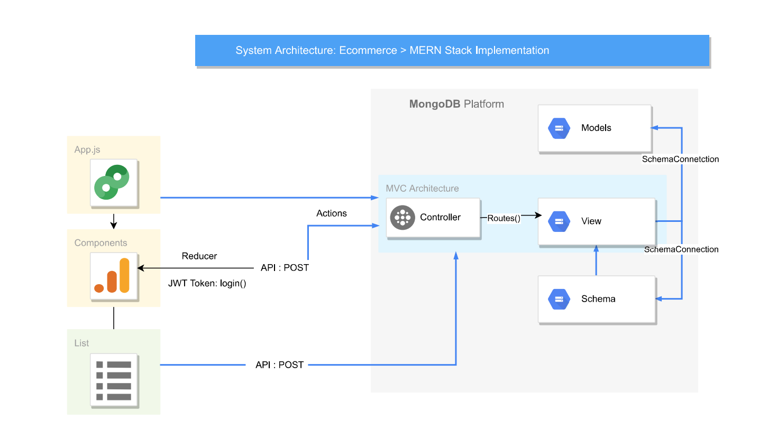
Coding Implementation

Slide 18
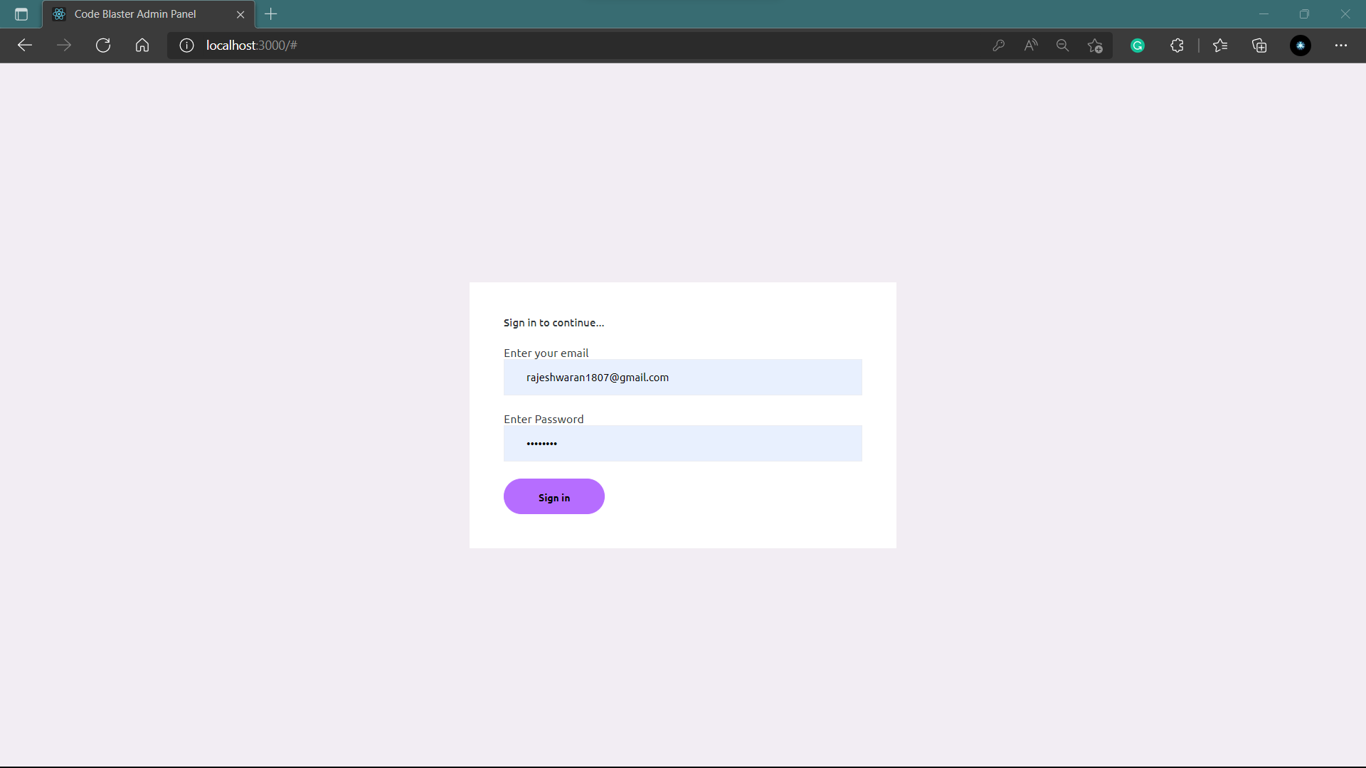
Output – Admin Login

Slide 19
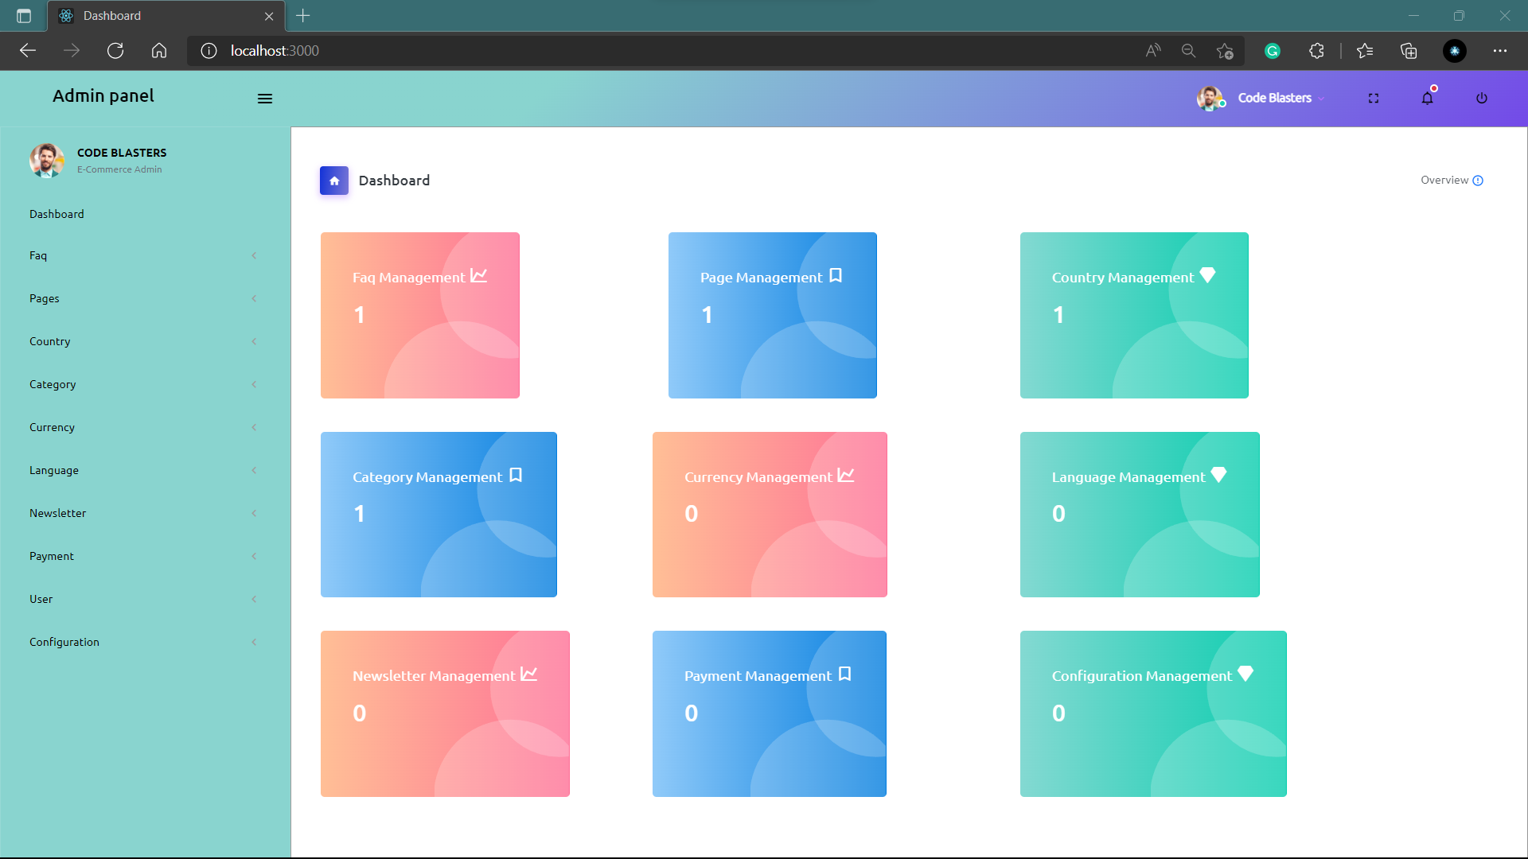
Output – Admin Dashboard

Slide 20
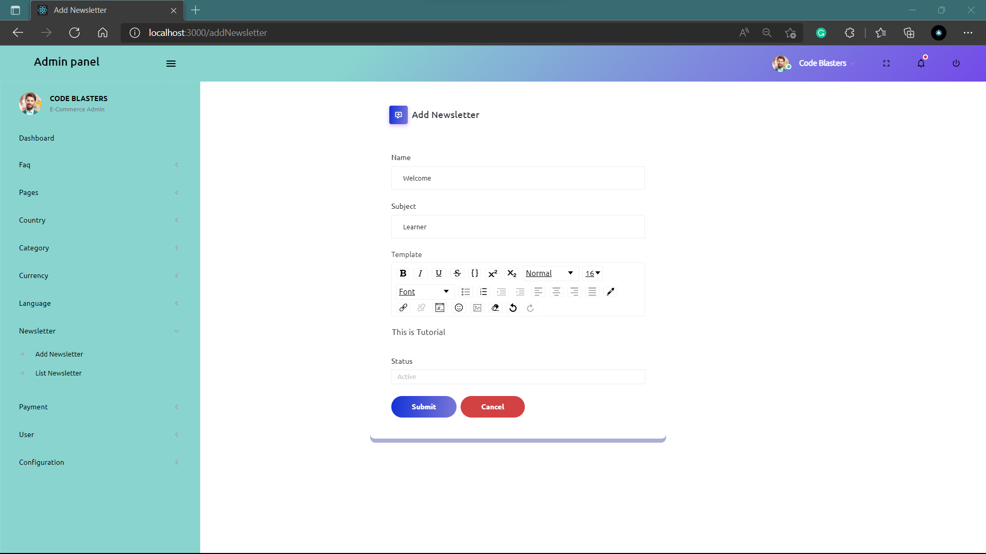
Output – Admin Add data

Slide 21
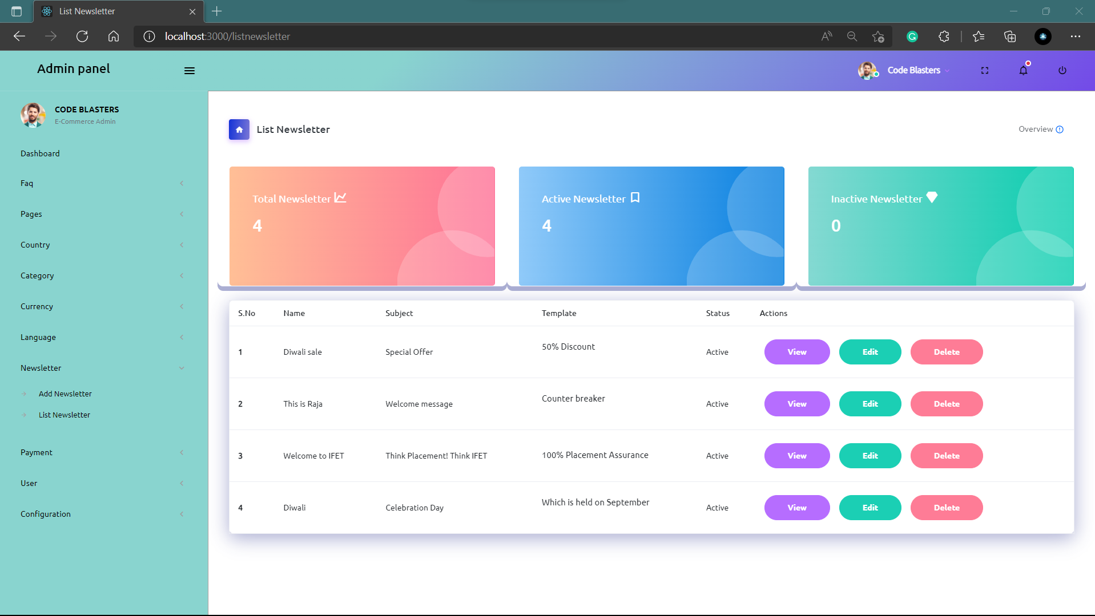
Output – Admin Panel List

Slide 22
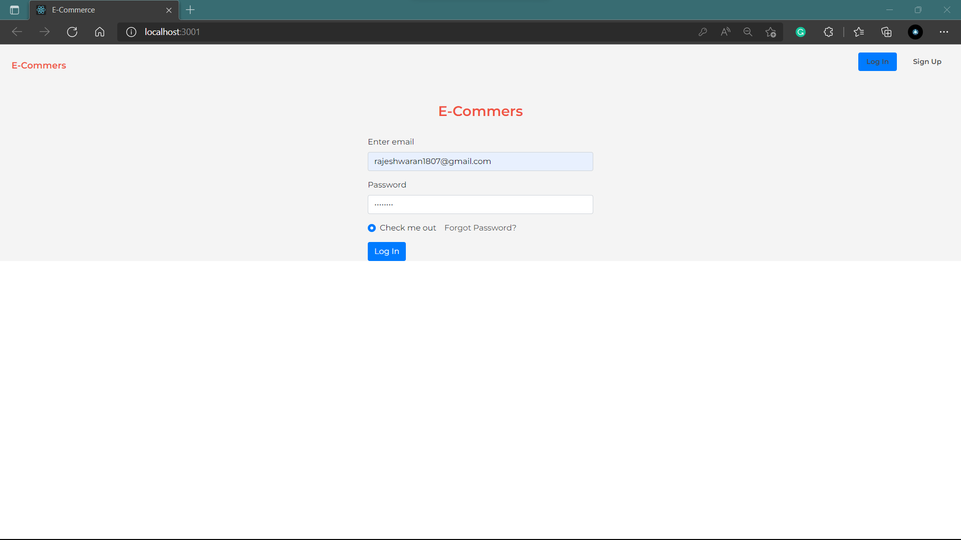
Output – Site Login

Slide 23
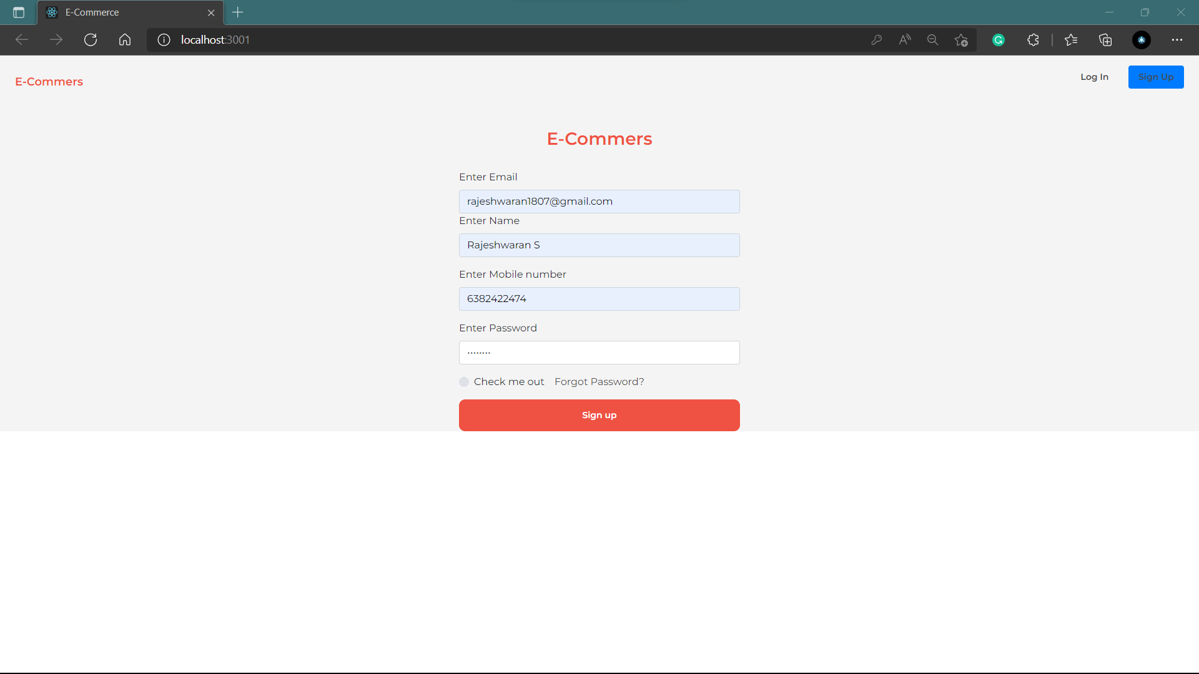
Output – Site Register

Slide 24
Conclusion
Let we conclude on our project review, there is various e-commerce site is rises exponentially in global.
But, Project is unique to communicate the customer to buy their products from our site, without any hassle.
This may useful for the people who have basic knowledge in the digital skilled person can not operate on our site without any prior knowledge on digital skills
This is will suggest the people to make a good decision to buy their product from our site.
Our main goal is to get trust from the customer to make a brand on our site like global sites.
We will implement our project the globalized standards to attract the customer locally and globally.

Slide 25

Any queries about Our E-Commerce site?

